Slide 1

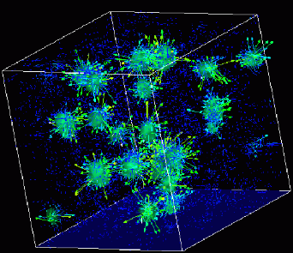

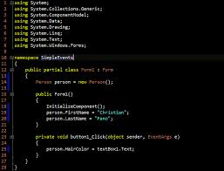
Advanced
Scientific Computing
(SciComp 201)
Session 29
kMeans Clustering

Slide 2
Session Goals
Gain an appreciation for k-means Clustering
Understand how the algorithm iterates by assigning data points to a cluster, and how we can use k-means to identify data outliers
Learn the limitations of k-means when “over fitting” data

Slide 3
k-means Clustering
k-means clustering aims to partition n observations into k clusters (where each cluster has its own $μ$point)
Each observation is assigned to the cluster whose $μ$point is closest to that observation’s point
The problem is computationally difficult (NP-hard); however, there are efficient heuristic algorithms that are commonly employed and converge quickly to a local optimum
The term "k-means" was first used by James MacQueen in 1967, though the idea goes back to Hugo Steinhaus in 1957
A more efficient version was published Hartigan and Wong in 1979

Slide 4
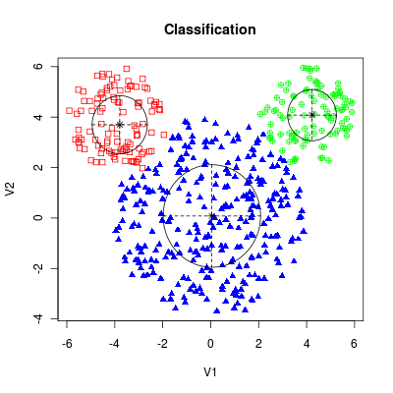
k-means Clustering

Slide 5
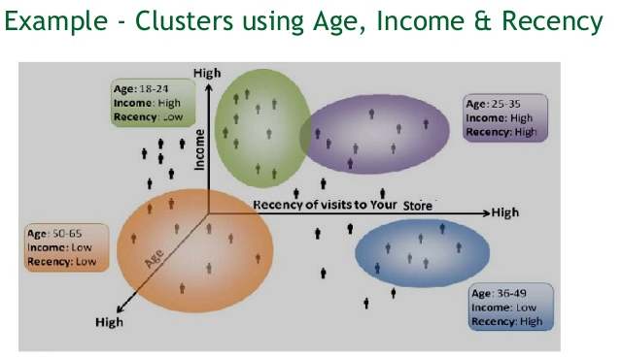
k-means Clustering

Slide 6
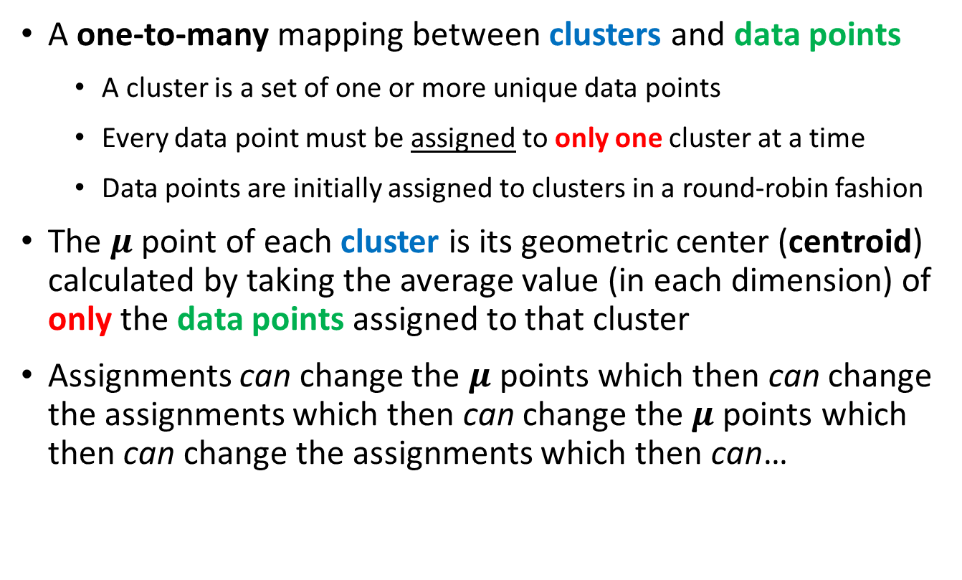
k-means Clustering
A one-to-many mapping between clusters and data points
A cluster is a set of one or more unique data points
Every data point must be assigned to only one cluster at a time
Data points are initially assigned to clusters in a round-robin fashion
The $μ$point of each cluster is its geometric center (centroid) calculated by taking the average value (in each dimension) of only the data points assigned to that cluster
Assignments can change the $μ$ points which then can change the assignments which then can change the $μ$ points which then can change the assignments which then can…

Slide 7
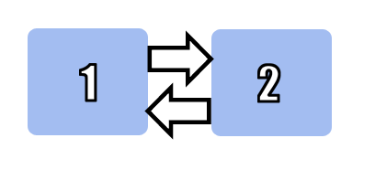
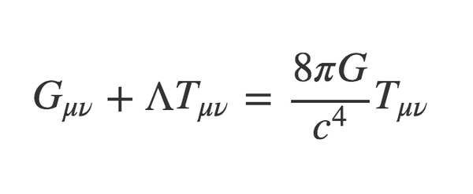
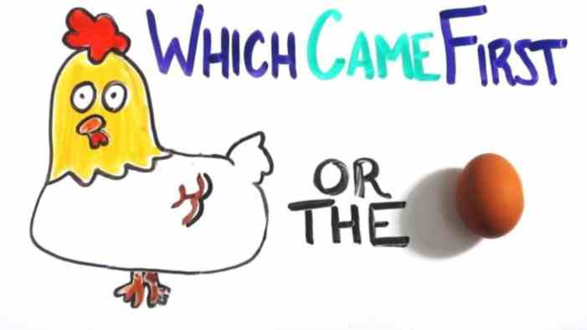
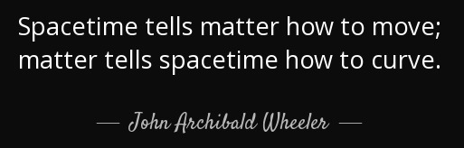
k-means Clustering
$μ$points
assignments

Slide 8
k-means Clustering
The algorithm iterates in a variable number of two-step rounds:
For each cluster, a new centroid ($μ$point) is calculated using the current data point assignments
If the new $μ$≠ current $μ$ then move cluster so current $μ$ = new $μ$
For each data point, find the cluster which has the closest $μ$point using Pythagorean distance formula
If necessary, reassign the data point to the new closest cluster - subject to constraint that every cluster must have one data point
The algorithm repeats rounds until no cluster moves or data point reassignments are needed $⇒$ “convergence”

Slide 9
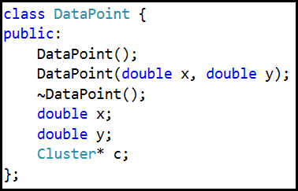
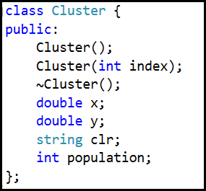
k-means Clustering

Slide 10
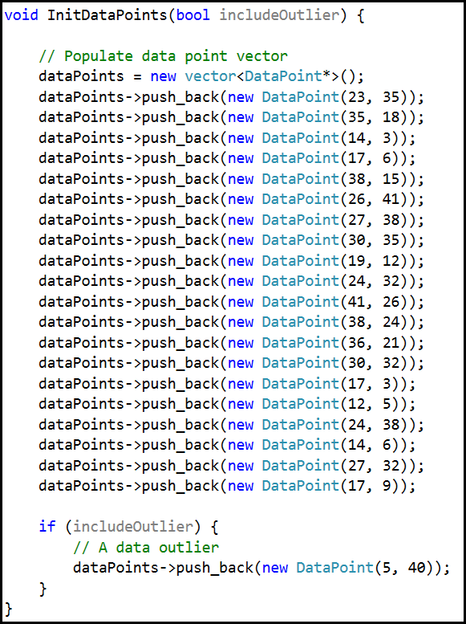
k-means Clustering
(x, y) coordinates of each data point

Slide 11
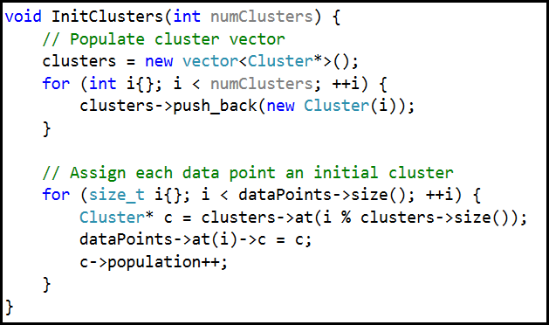
k-means Clustering

Slide 12
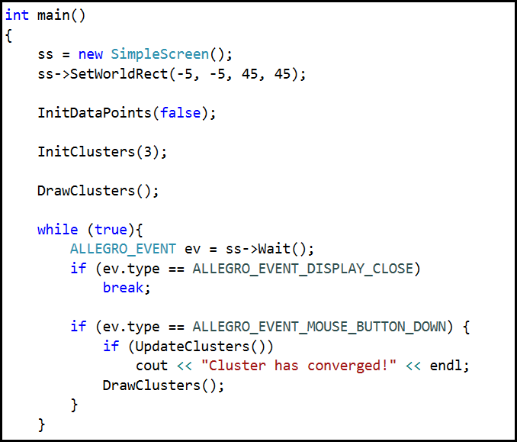
k-means Clustering

Slide 13
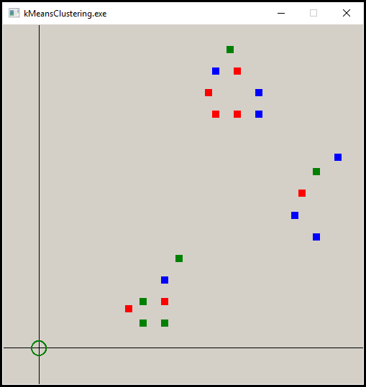
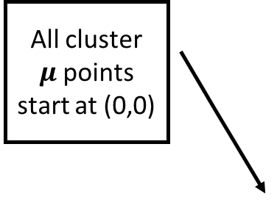
k-means Clustering – Round 1
Data points initially assigned in plain ordinal sequence to a cluster
All cluster $μ$points start at (0,0)
Single left click anywhere in the form’s client area to advance one round

Slide 14
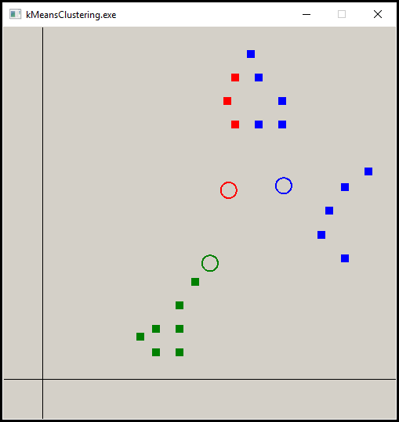
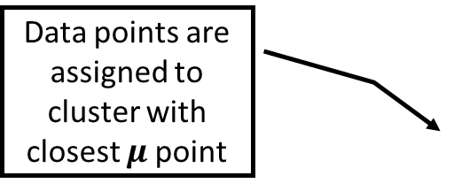
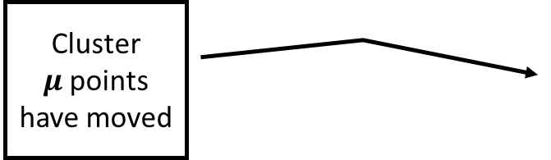
k-means Clustering – Round 2
Data points are assigned to cluster with closest $μ$point
Cluster $μ$points have moved
The algorithm is trying to converge to three clusters

Slide 15
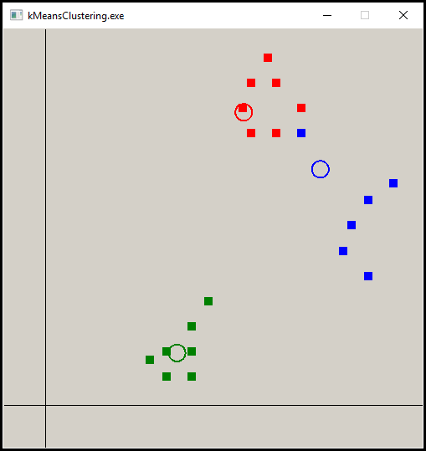
k-means Clustering – Round 3

Slide 16
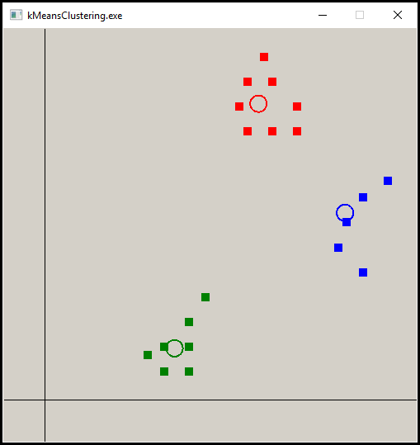
k-means Clustering – Round 4

Slide 17
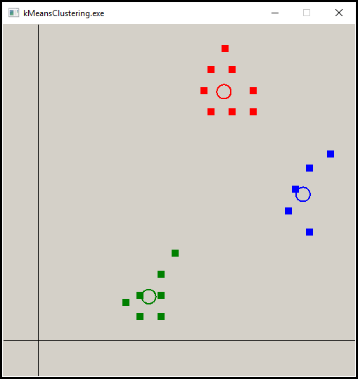
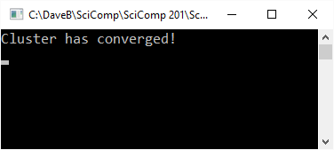
k-means Clustering – Converged
No data points have changed their cluster assignment
No cluster $μ$points have moved

Slide 18
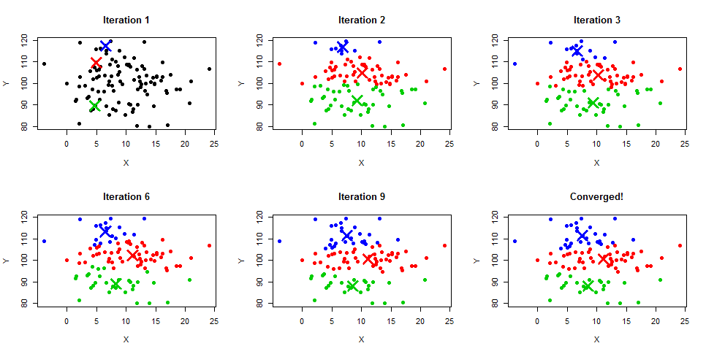
k-means Clustering

Slide 19
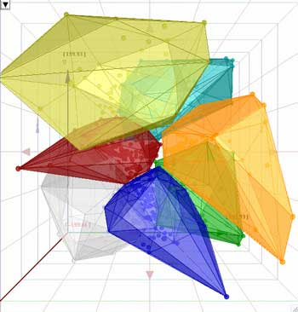
n-Dimensional k-means Clustering

Slide 20
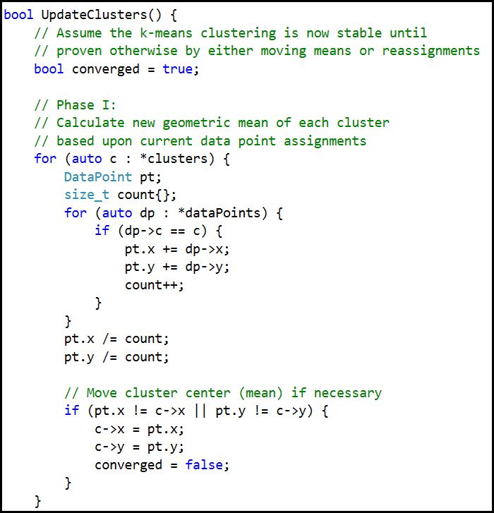
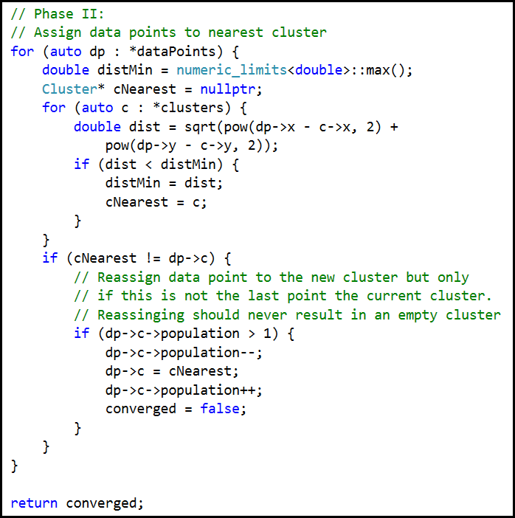
k-means Clustering

Slide 21
Identifying Data Outliers
Once we have data partitioned into clusters, we can eliminate outliers by evicting any data points whose distance from the converged cluster’s $μ$ point is too large
The data points should be distributed around the cluster’s $μ$point in a normal distribution. 99.97% of data points should be $≤3σ$from the mean
If a data point is $>3σ$ from the $μ$point of its cluster, it probably is an outlier and should be evicted (assigned to a different cluster)
After we evict a data point, we iterate the algorithm all over again
If a data point winds up getting evicted from all clusters, it is probably a data capture error or a statistical anomaly

Slide 22

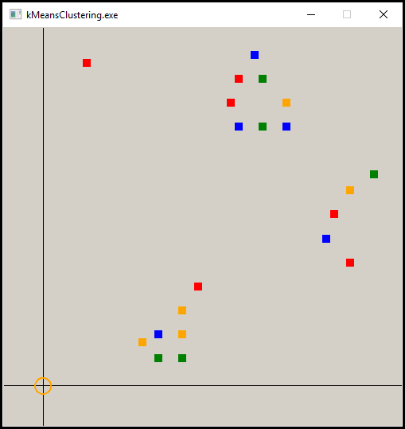
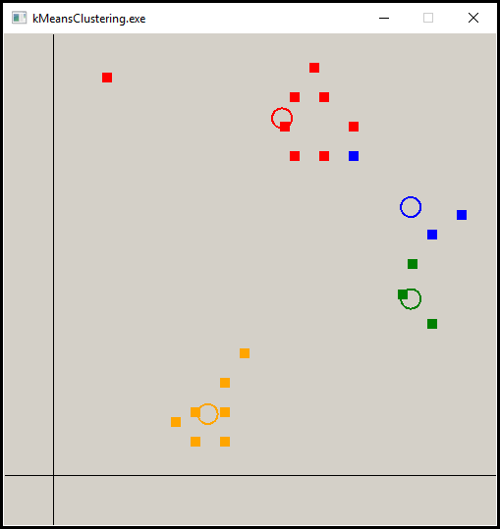
Identifying Data Outliers
The outlier skews the red and blue clusters

Slide 23

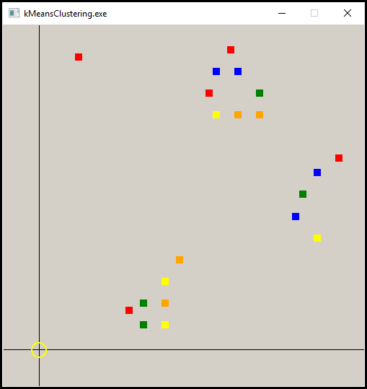
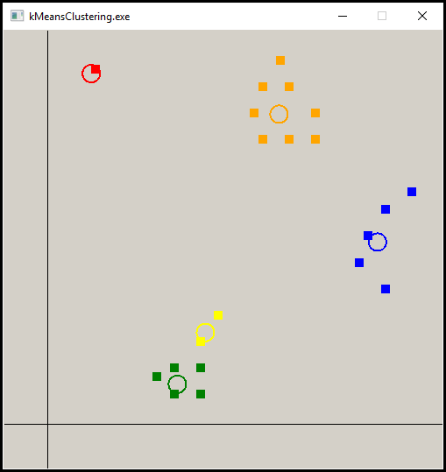
Identifying Data Outliers
The outlier is now its is own cluster

Slide 24
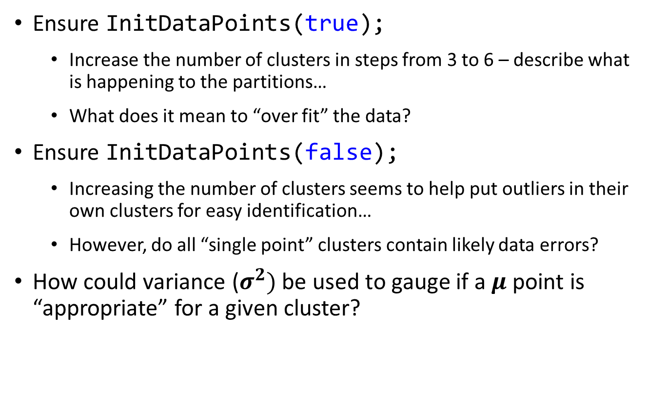
Lab 1 - Questions
Ensure InitDataPoints(true);
Increase the number of clusters in steps from 3 to 6 – describe what is happening to the partitions…
What does it mean to “over fit” the data?
Ensure InitDataPoints(false);
Increasing the number of clusters seems to help put outliers in their own clusters for easy identification…
However, do all “single point” clusters contain likely data errors?
How could variance ($σ^{2})$ be used to gauge if a $μ$point is “appropriate” for a given cluster?

Slide 25
Now you know…
k-means clustering can be used to categorize data points by its nearness to a similar group’s statistical means
Data sets which are homogenous (have a more uniform distribution of values) may not converge to a meaningful set of clusters since the data lacks sharpness
We can use k-means to identify data outliers so we can avoid allowing those anomalies from skewing the main observations – this process is called evicting a point from the cluster
k-means clustering can be extended into multiple dimensional data sets

